Slide 1
Email Basics
Front-End Web Development

Slide 2
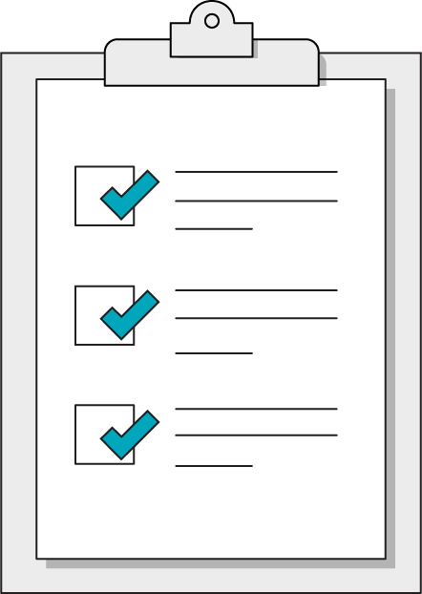
Today’s Learning Objectives
In this lesson, you will:
Learn the basics of email layout
Understand the rendering environment that emails use
Understand how to send out emails
‹#› | © 2020 General Assembly

Slide 3
Warm Up - The Bad Intern
Front-End Web Development

Slide 4
The Bad Intern
30 minutes
Our horrible intern has gone full agricultural on us! This time they’ve broken a horse farm’s page! Fix it before the client sees it!
Starter code:
https://drive.google.com/drive/folders/1Shl8pzw46EuqCey6TyKnLWOma0NiMTqG?usp=sharing

Slide 5
Rendering Email
Front-End Web Development

Slide 6
Email HTML… Timewarp to 1999 (almost)
In the web, we have theoretically 4 major layout techniques:
Tables (obsolete for layout)
Floats
Flexbox
CSS-Grid
@

Slide 7
Email HTML… Timewarp to 1999 (almost)
For email we have one:
Tables
@

Slide 8
Table-based Layout
It’s kinda like a primitive version of grids.
@

Slide 9
Table-based Layout
It’s kinda like a primitive version of grids.
@

Slide 10
Table-based Layout
It’s kinda like a primitive version of grids.
@

Slide 11
Why?
Outlook uses Microsoft Word to render HTML/CSS
Web-based email applications selectively strip CSS
Gmail
Yahoo
Outlook for the Web
Squirrel Mail
ProtonMail
Yandex.Mail
AOL
etc.
@

Slide 12
Building & Styling Emails
Front-End Web Development

Slide 13
The Return of Attributes
Element | Description
border | Defines the width of the border (INT only)
align | Describes alignment (left, center, right)
bgcolor | Background color of cell/tag
cellpadding | Similar to padding but for table cells
width | The width of the tag

Slide 14
Web Fonts
@font-face {
font-family: 'Merriweather';
font-style: normal;
font-weight: 400;
src: local('Merriweather'), local('Merriweather'), url(http://fonts.gstatic.com/s/merriweather/v8/ZvcMqxEwPfh2qDWBPxn6nmB7wJ9CoPCp9n30ZBThZ1I.woff) format('woff');
}

Slide 15
Email Template
30 minutes
Our team has started building a generic email template. Grab the instructions in the Readme and see if you can finish the construction!
Starter code:
https://drive.google.com/drive/folders/176GHDxZD7w10cXsNhHtP3Q8bdYh-l3Zt?usp=sharing

Slide 16
Sending Emails
Front-End Web Development

Slide 17

Don’t Send It Yourself
Use a bulk email provider.

Slide 18
Next Class… Student’s Choice
Front-End Web Development

Slide 19
Students Choice
More Ajax & API
Google Analytics
Google Tag Manager
Jekyll & Github
jQuery
SASS
WordPress Themes
React Intro (limited)
MySQL
Build a To-Do App
Layout Exercises
Node
More complicated JS

